Slide 1

Amazon e-Commerce Data Analysis using Power BI
Daithiya Sudan K S
11/02/2024

Slide 2
About Amazon
Amazon Users Can Donate to Charities When they Buy
AmazonSmile allows its users to support charities of their choice when they shop at smile.amazon.com. The AmazonSmile Foundation donates 0.5% of the purchase price of products eligible for AmazonSmile purchases.
It Sold Its First Book in 1995
The first book ever sold on Amazon was Fluid Concepts and Creative Analogies by Douglas Hofstadter, according to a Quora question answered by former Amazon employee Ian McAllister. The book was purchased in 1995 and it's believed that John Wainwright was the customer, claiming to have purchased the book on April 3rd, 1995.

Slide 3
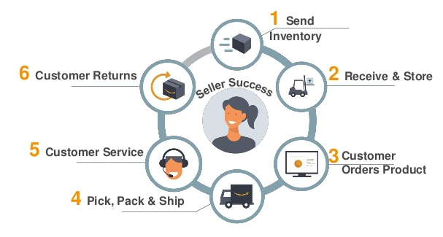
About Amazon

Slide 4

Data Overview
Total revenue generated from delivered orders is $77.87M
Total count of distinct products is 44.
Average days taken to deliver is 9 days.
Total number of records present in the dataset is 113000.
Highest unit price for a product is $4700 and the second highest is for $2700 and both are cameras.
Lowest unit price for a product is $15.

Slide 5

Why data is important?
Data helps you make better decisions
Data helps you solve problems
Data helps you understand performance
Data helps you improve processes
Data helps you understand consumers

Slide 6
Problem Statement
Perform comprehensive data analysis on Amazon's e-commerce platform to uncover insights and patterns that enhance user experience, optimize operations, and drive business growth.
This analysis should encompass diverse aspects including user behavior, product performance, market trends, and operational efficiency.
The goal is to leverage data-driven decision-making to improve customer satisfaction, increase sales, optimize inventory management, and identify opportunities for innovation and strategic expansion within the competitive e-commerce landscape.

Slide 7
Data Cleaning Process
Removed all the empty rows and columns.
Added a custom column to replace all the empty cells of reason for returned orders with “Not mentioned”
Added a new column to calculate the number of days taken to deliver the order

Slide 8
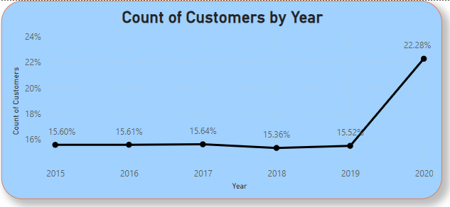
Customers every year
Drag the sale price into the chart and use a card to display the values.
Considering that the refund would have been issued for all the returned orders, filter the revenue only for the delivered order.

Slide 9
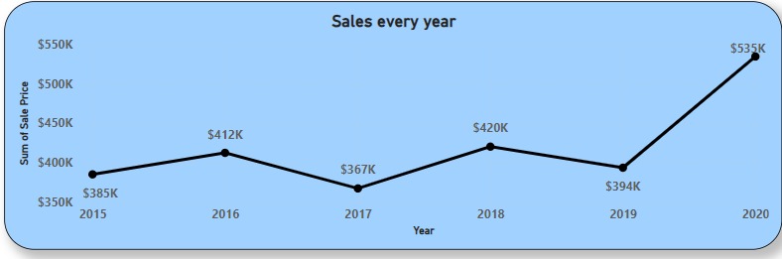
Sales By Year
There has been increase and decrease in sales for all the products over the years.
But in common, all the products were bought more in 2020. Reason could be because of the pandemic.

Slide 10
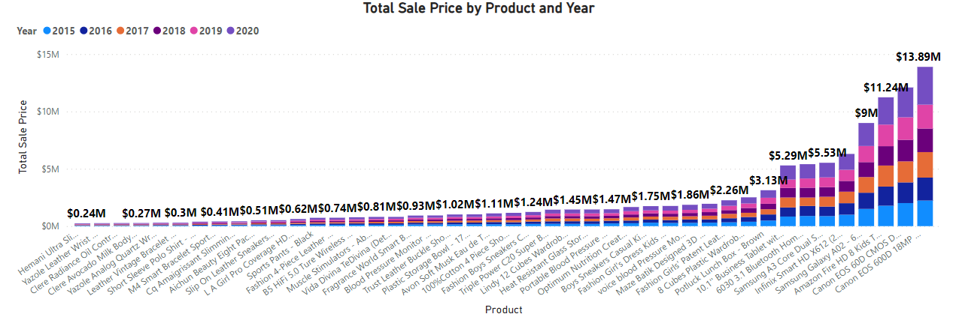
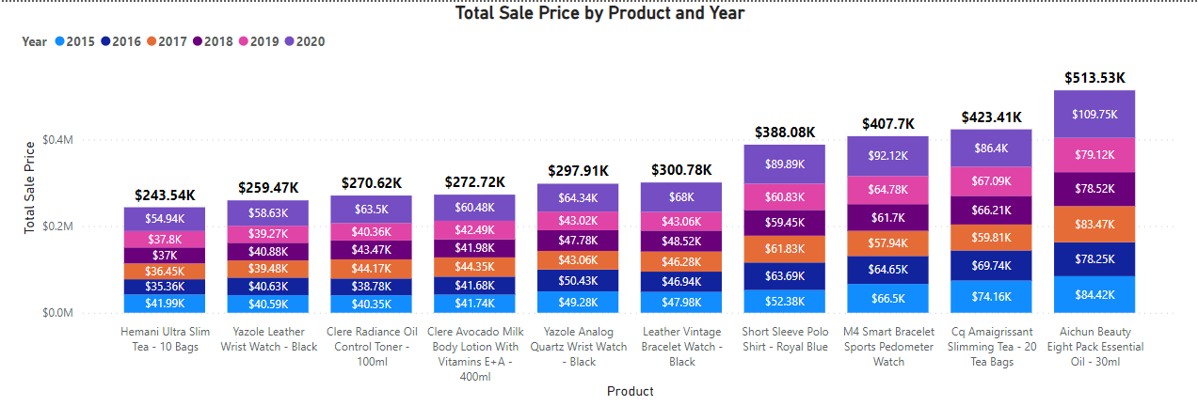
Total Revenue of each product each year
First visual depicts the total sales done by each product in each year. The most sold product being
“Canon EOS 600D 18MP CMOS DSLR Camera - Black” contributing 12.95% of the total sales and least
sold product being “Hemani Ultra Slim Tea - 10 Bags” contributing to 0.01% of the total sales.
Second visual zooms into the bottom 10 products which were least sold and the management can promote those products in order to gain more profit.

Slide 11
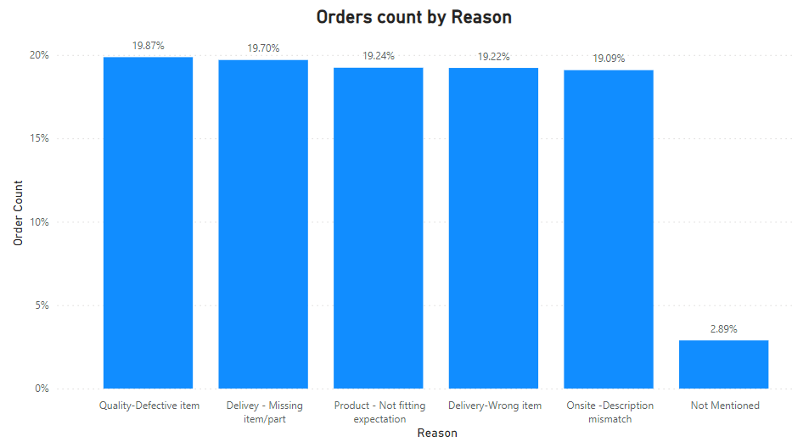
Returned order count by reason
There are totally 30.53K orders returned which is 26.85% of the total orders received.
Most of the orders where returned due to Quality or defective items which
contributes to 19.87% of the total returns.

Slide 12
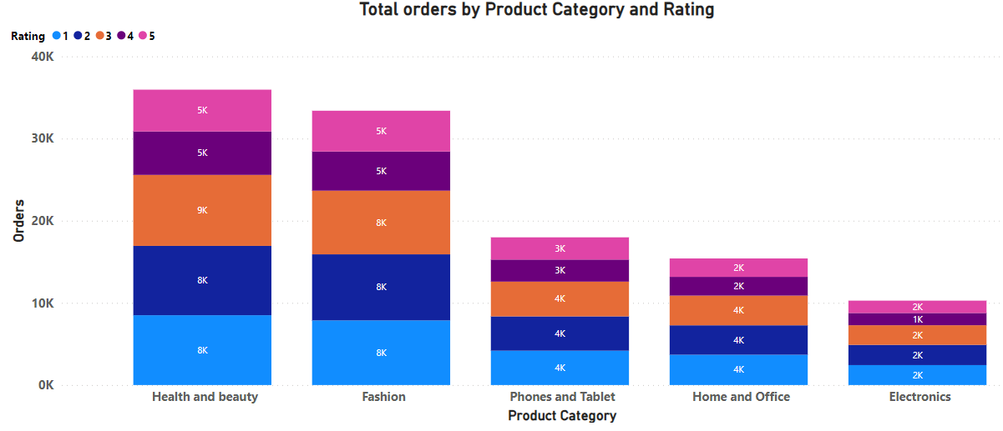
Order count by category and rating
Rating of 1,2 and 3 have been given to most of the products in each category which accumulates to 79K orders.
Rating of 4 and 5 have been given to only few of the orders in each category which only accumulates to 33K orders.

Slide 13
Order count by category and rating(cont.d)
Recommendations:
The management has to be a little more careful while letting the sellers sell their product in their website. Ratings could define the quality of the product.
If the customers observe that about the less ratings given by the other customers more to the product, that product has to be removed from the site so that the future customers get to see only the products with good quality.

Slide 14
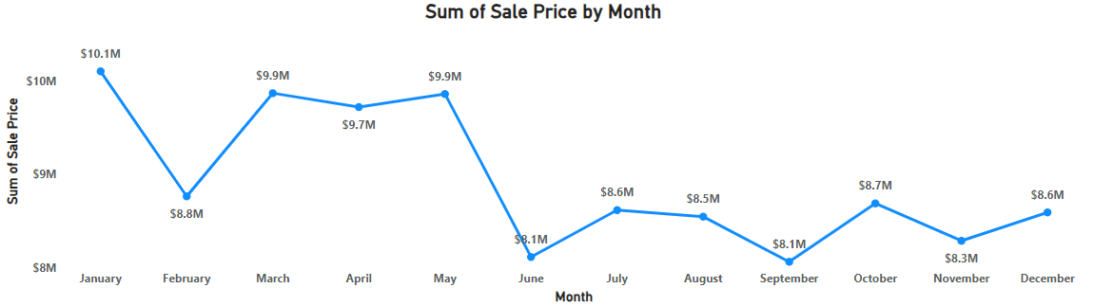
Revenue month-wise
The most revenue has come from the month of January with a whopping $10.1M.
The least revenue has come in the month of June and September with a revenue of $8.1M in each month.
There has been a dip in the revenue generated from January to February make a difference of $1.3M in sales.

Slide 15
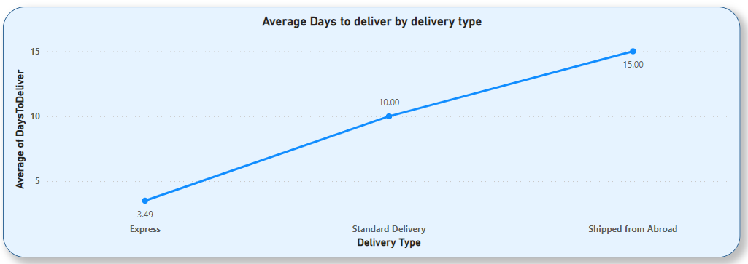
Average days taken to deliver by delivery type
Express delivery type seems to deliver the product in 3.5 days per order.
Whereas, shipping an order from abroad seems to take 15 days to reach the customer.

Slide 16
Strategic recommendations
Charge a penalty for no reason
Ship in a well-protected container
Discount on low selling products
Target the right age group
Promote express delivery by a subscription
Season based promotion

Slide 17
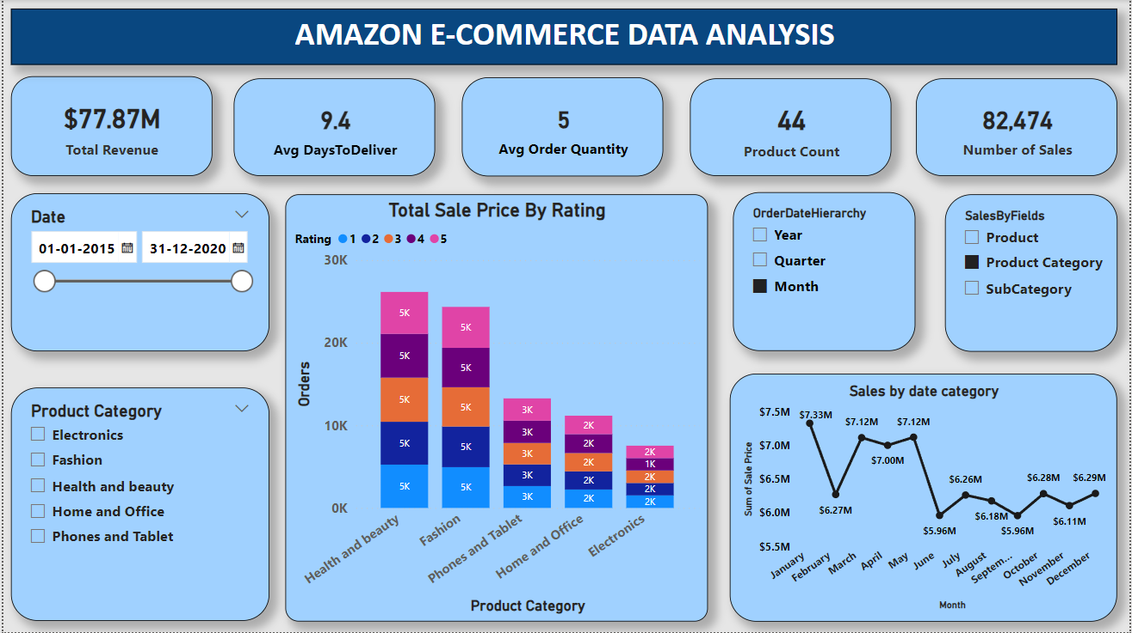
Main Tab

Slide 18
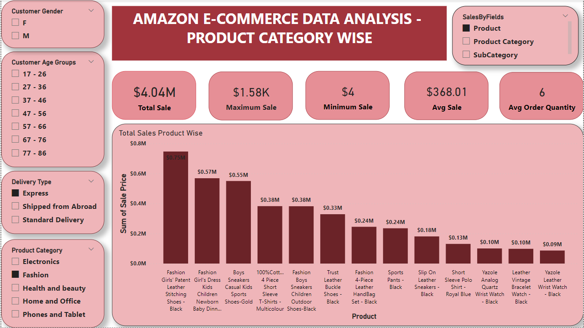
Product Tab

Slide 19
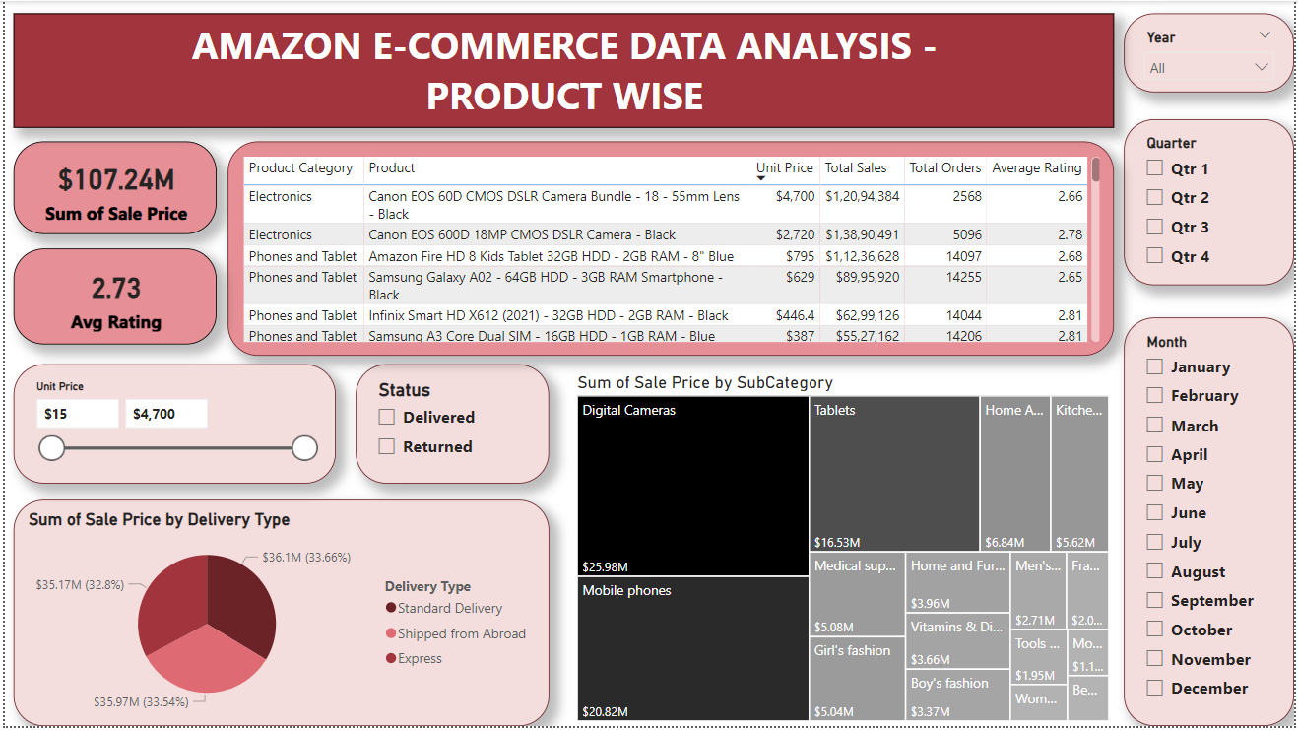
Individual Product Tab

Slide 20
Conclusion
Most of the customers placed an order in 2020 which contributed to 22.28% of the total orders.
In the same year, there was a total revenue of $535K generated.
“Canon EOS 600D 18MP CMOS DSLR Camera - Black” contributed 12.95% of the total revenue making a revenue of $1,38,90,491
“Hemani Ultra Slim Tea - 10 Bags” contributing to 0.01% of the total revenue making a total sales of $2,43,540.
Target on the right age group on the product to generate more revenue.
Can use television ads, newspaper ads and social media as the promoting platforms for the business.

